Slide 1

An Introduction to
The Beam Model
Apache Beam
Slides by Tyler Akidau & Frances Perry, April 2016
Notes:
These slides provide a detailed introduction to the Apache Beam model. You are welcome to reuse all or some of these slides when discussing Apache Beam, but please give credit to the original authors when appropriate. ;-)
Frances Perry (fjp@google.com)
Tyler Akidau (takidau@google.com)
Please comment if you have suggestions or see things that are out of date -- we’d like to keep these fresh and usable for everyone.
These slides were adapted in part from a talk at @Scale in Sept 2015:
https://www.youtube.com/watch?v=3UfZN59Nsk8
but updated to refer to Apache Beam and include some newer material from a talk at GCP Next in March 2016:
https://www.youtube.com/watch?v=mJ5lNaLX5Bg
Depending on your audience, you may want to adjust or augment this material with other Beam talks.

Slide 2
Agenda
Infinite, Out-of-order Data Sets
The Evolution of the Beam Model
What, Where, When, How
Apache Beam
1
2
3
4
Notes:
We’ll start by introducing the types of problems that motivated the Beam model, and then discuss how these problems motivated the evolution of MapReduce into Beam.
Next, we’ll discuss the Beam model in detail -- diving into the key questions that make up the model.
And finally, we’ll discuss the donation of this model to the Apache Software Foundation and the bootstrapping of the Apache Beam project.

Slide 3
Infinite Out-of-Order Data Sets
1
Notes:
First, let’s set the stage by discussing a driving use case.

Slide 4



Goals:
Write interesting computations
Run in both batch & streaming
Use custom timestamps
Handle late data
https://commons.wikimedia.org/wiki/File:Globe_centered_in_the_Atlantic_Ocean_(green_and_grey_globe_scheme).svg
Notes:
During this talk, we’ll use a running example where we’ve just created a new, totally addictive mobile game where individual users do some sort of repetitive mind-numbing task to earn points for their team, be it the red circles or the green triangles.
In order to make sure our game succeeds, we want to track all sorts of usage statistics, like the total score per team. Some of our uses are traditional batch and others are streaming computations. Since our game supports an offline mode, we need the flexibility to use custom timestamps and easily handle late data.

Slide 5
Data...
Notes:
Here’s our collection of events where each event is a user doing whatever silly task it is they do to earn points.

Slide 6
...can be big...
Notes:
Hopefully our game gets really popular, so the collection of events might get really large.

Slide 7
...really, really big...
Thursday
Wednesday
Tuesday
Notes:
Maybe it gets so large that we start organizing it into a repeated structure, like organizing it daily.

Slide 8
… maybe infinitely big...
14:00
7:00
13:00
6:00
12:00
5:00
11:00
4:00
10:00
3:00
9:00
2:00
8:00
1:00
Notes:
But really, this type of repetitive structure is often just a cheap way of representing an infinite data source.
Once our game launches to the world, there’ll always be someone online playing. The data just keeps coming...

Slide 9
… with unknown delays.
8:00
8:00
8:00
14:00
13:00
12:00
11:00
10:00
9:00
8:00
Notes:
But whenever we’re dealing with data collected from widely distributed places, we need to be able to deal with a little ambiguity. There were three users playing our game at 8am.
<animate> For one of those users we received that event pretty much immediately -- right after 8am.
<animate> However, this is a distributed system, so there’s often going to be a little bit of a delay. Here’s a score that occurred at 8am, but didn’t get us til closer til 8:30am later due to some network congestion.
<animate> But here’s an element that was hours late. This could have been due to a one-off issue like a fiber cut across Atlantic. But it also could be because the user was happily playing our game while in airplane mode on a transpacific flight or camping overnight in the woods with no cell reception.
And as we process our infinite, unordered data, we find that there are tradeoffs that have to be made....

Slide 10
Data Processing Tradeoffs
$$$
1 + 1 = 2
Completeness
Latency
Cost
Notes:
If we want to have complete, correct results for exactly how many users played our game today, we’ll have to wait for all the flights to land and all the campers to return to civilization.
But often we want results quickly -- not only do we not want to wait for those delayed events, we may even want speculative results before today even ends.
And each time we adjust our requirements to get more, faster, there’s an additional cost associated with the computational resources.
The right tradeoff depends totally on the use case. So let’s look at a handful...

Slide 11
Requirements: Billing Pipeline
Important
Not Important
Completeness
Low Latency
Low Cost
Notes:
For a billing pipeline to charge our advertisers for ads shown, we’ve got to charge them the right amount. So data completeness is very important -- we need to wait until we have all the data before sending them that monthly bill.
Low latency isn’t that important -- it’s ok if we run a job overnight once a month.
And given that money is involved -- we’re ok spending money ourselves to get that answer.

Slide 12
Requirements: Live Cost Estimate Pipeline
Important
Not Important
Completeness
Low Latency
Low Cost
Notes:
But say we wanted to give users a running estimate of their bill, so they could avoid surprises at the end of the month.
Now it’s less important that we chase every little charge and more important that we get the latency down.
In other words, we’re taking a traditional batch algorithm and applying it in a streaming manner.

Slide 13
Requirements: Abuse Detection Pipeline
Important
Not Important
Completeness
Low Latency
Low Cost
Notes:
In a different domain, we could be attempting to identify users that are spamming or abusing our system.
Here, we’re likely using a heuristic threshold anyway, so completeness of the data can be a bit fuzzy.
However, having low latency is really important, so that we can quickly block the problematic users.

Slide 14
Requirements: Abuse Detection Backfill Pipeline
Important
Not Important
Completeness
Low Latency
Low Cost
Notes:
But while our live system is running, we also want to fine tune our abuse detection algorithms.
So here, we’d like to running that same type of streaming algorithm, but run it over large amounts of historical data, in order to evaluate how to improve the algorithm.
Now latency isn’t a big deal, but we’d like to keep things cheap so we can try lots and lots of permutations.

Slide 15
The Evolution of the Beam Model
2
Notes:
So now let’s see how systems at Google evolved to address these types of tradeoffs.

Slide 16
MapReduce: Batch Processing
(Prepare)
Map
(Shuffle)
Reduce
(Produce)
Notes:
Good old MapReduce
<animate> First you divide your dataset up into chunks and hand each chunk out to a different machine.
<animate> Those machines take the Map function, which explains how to transform an element, and run it over each element in their chunk.
<animate> Each machine can process it’s chunk independently.
<animate> During the shuffle phase, each mapping machine sends its output elements to a set of reducing machines, choosing the correct machine for each element.
<animate> Each reducing machine applies a Reduce function over its set of elements… <animate>
<animate> and finally the resulting elements are gathered up into the final output.
MapReduce is a powerful hammer. So engineers both within Google and beyond began using it for any and all big data nails. Almost any complex data processing algorithm can be crammed into the rigid Map-Shuffle-Reduce framework if you are willing to distort it beyond recognition...

Slide 17
FlumeJava: Easy and Efficient MapReduce Pipelines
Higher-level API with simple data processing abstractions.
Focus on what you want to do to your data, not what the underlying system supports.
A graph of transformations is automatically transformed into an optimized series of MapReduces.
Notes:
Google engineers developed FlumeJava as a higher-level abstraction built on top of MapReduce.
FlumeJava lets users deal with their algorithms and let the system figure out how to cram it into a MapShuffleReduce shape by doing things like function composition.
As with MapReduce, Google published a paper on FlumeJava but kept the implementation internal.

Slide 18
Batch Patterns: Creating Structured Data
MapReduce
Notes:
FlumeJava and MapReduce can be used to do things like transforming, filtering, and aggregating collections of data.

Slide 19
Batch Patterns: Repetitive Runs
Thursday
Wednesday
Tuesday
MapReduce
Notes:
These batch systems can handle that repetitive structure by running repeated batch jobs, like processing daily log files each night via a cron script.

Slide 20
Batch Patterns: Time Based Windows
Tuesday
[11:00 - 12:00)
[12:00 - 13:00)
[13:00 - 14:00)
[14:00 - 15:00)
[15:00 - 16:00)
[16:00 - 17:00)
MapReduce
[18:00 - 19:00)
[19:00 - 20:00)
[21:00 - 22:00)
[22:00 - 23:00)
[23:00 - 0:00)
Notes:
They can be used to subdivide and partition datasets, for example taking daily logs, and computing top users per hour.
But of course, doing this in a nightly batch job, means we might be waiting upwards of 23 unnecessary hours for that first result.

Slide 21
Batch Patterns: Sessions
Tuesday
Wednesday
Tuesday
Wednesday
Jose
MapReduce
Lisa
Ingo
Asha
Cheryl
Ari
Notes:
Another common pattern is sessions. Sessions capture bursts of user activity terminated by a timeout -- so for example a user might be playing our game while during a commercial break, but then stops when their show resumes.
Producing sessions via sequential batch runs is possible, but leads to broken sessions if a user session spans batches, because we’ve forced that infinite data set into fixed chunks. Here Jose’s sessions are messed up, though Lisa’s are ok.
So batch can handle many common patterns, but leaves us with a wishlist of things like lower latency and the ability to handle truly continuous data.
These drawbacks led to the development of streaming systems, and inside Google, that means MillWheel...

Slide 22
MillWheel: Streaming Computations
Framework for building low-latency data-processing applications
User provides a DAG of computations to be performed
System manages state and persistent flow of elements
Notes:
Millwheel is a framework for building continuous data processing systems.
Again, users specify a graph of computations to be performed, and the system deploys machines to do each step in the graph and pushes elements through the steps.

Slide 23
Streaming Patterns: Element-wise transformations
8:00
9:00
10:00
11:00
12:00
13:00
14:00
Processing Time
Notes:
As a streaming system, Millwheel naturally handles unbounded, infinite collections of data.
Element wise transformations like filtering can simply be applied as elements flow past.

Slide 24
Streaming Patterns: Aggregating Time Based Windows
8:00
9:00
10:00
11:00
12:00
13:00
14:00
Processing Time
Notes:
However, for aggregations that require combining multiple elements together, we need to divide the infinite stream of elements into finite sized chunks that can be processed independently.
The simplest way to do this is just to take whatever elements we see in a fixed time period.
But, like we saw earlier, elements often get delayed, so this might mean we’re processing a bunch of events where most occurred between 1 and 2pm, but there are still a few stragglers from 9am showing up.

Slide 25
Streaming Patterns: Event-Time Based Windows
Input
Processing Time
10:00
11:00
12:00
13:00
14:00
15:00
Output
Event Time
10:00
11:00
12:00
13:00
14:00
15:00
Notes:
What we often want instead is to process elements in batches based on when they occurred, instead of when they arrived in the system.
In this diagram, we’re still doing fixed size batches of data, but using the element’s event time, not it’s arrival time, which requires some reorganization of data. Here the red element arrived relatively on time and stays in the noon window. However the green that arrived at 12:30, was actually created about 11:30, so it moves up to the 11am window.

Slide 26
Streaming Patterns: Session Windows
Input
Processing Time
10:00
11:00
12:00
13:00
14:00
15:00
Output
Event Time
10:00
11:00
12:00
13:00
14:00
15:00
Notes:
There are other ways to organize infinite data into event time based windows.
Just like in batch, we can capture bursty user interactions in Sessions -- but in streaming we don’t have any artificial breaks to deal with.
No matter how we constructed our finite windows out of our infinite stream, we have to make this delay between event time and processing time concrete...

Slide 27
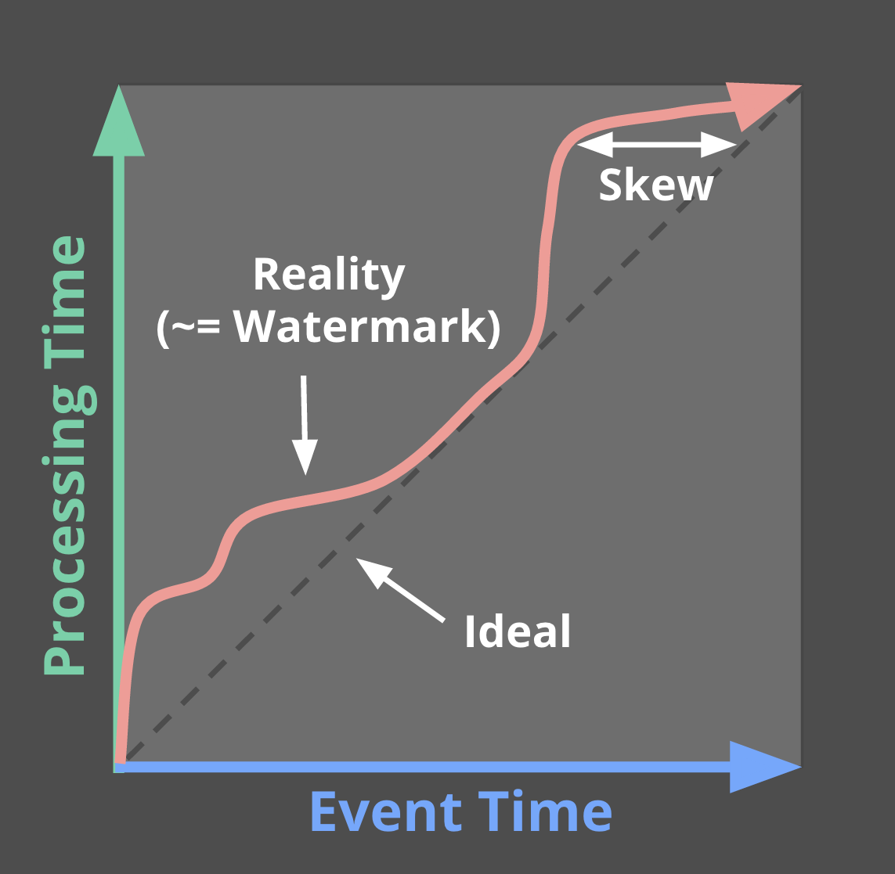
Formalizing Event-Time Skew
Watermarks describe event time progress.
"No timestamp earlier than the watermark will be seen"
Often heuristic-based.
Too Slow? Results are delayed.
Too Fast? Some data is late.
Notes:
Here the blue axis is event time and the green access is processing time.
In an ideal world, there’d be no delay between event time and processing time, so our elements would be processed right when they occurred, right along the dashed line. But reality looks more like that red squiggly line, where processing time is slightly delayed off event time.
The distance between reality and ideal is called skew. And variable skew is what makes it really hard to reason about completeness.
We call this red line the watermark. It declares that no event times earlier than this point are expected to appear in the future.
Ideally, we’d have perfect knowledge about this and our watermark would be correct. Some input sources, like monotonically increasing log file entries, support a perfect watermark. But others, like our arbitrary stream from mobile devices make this much harder, and we have to rely on a heuristic. If our heuristic is too slow, then we’re waiting longer than needed to process results, introducing unnecessary latency. If our heuristic is too fast, then some data comes in late after we thought we were done for a given time period.
The watermark, and the complications it causes, lead us straight back to those underlying tradeoffs...

Slide 28
Streaming or Batch?
$$$
1 + 1 = 2
Completeness
Latency
Cost
Why not both?
Notes:
Do we want the completeness that comes from having all our data available like in traditional batch?
Do we want faster updates like in streaming?
The more data we buffer and the more often we process elements, the higher the resource cost.
And while we could choose between batch or streaming, the examples we looked at earlier show that we often want to apply the same type of algorithm with different tradeoffs.
And if there’s one thing engineers dislike, it’s inefficiencies. Ease of use is a huge factor, so we wanted to get to a point an algorithm only has to be written once.

Slide 29
What, Where, When, and How
3
Notes:
So now let’s dig in to this new model.
Again, we’re trying to reason about infinite, out-of-order data sets. And that’s really tricky to do… unless you know what questions to ask.

Slide 30
What are you computing?
Where in event time?
When in processing time?
How do refinements relate?
Notes:
The Beam model is based on four key questions:
What results are calculated? Are you doing computing sums, joins, histograms, machine learning models?
Where in event time are results calculated? How does the time each event originally occurred affect results? Are results aggregated for all time, in fixed windows, or as user activity sessions?
When in processing time are results materialized? Does the time each element arrives in the system affect results? How do we know when to emit a result? What do we do about data that comes in late from those pesky users playing on transatlantic flights?
And finally, how do refinements relate? If we choose to emit results multiple times, is each result independent and distinct, do they build upon one another?
Let’s dive into how each question contributes when we build a pipeline.

Slide 31
What Where When How
What are you computing?
Element-Wise
Aggregating
Composite
Notes:
The first thing to figure out is what you are actually computing.
Some transformations take a collection of elements and transform each element independently, similar to the Map function in MapReduce. Because each element can be transformed without looking at any other elements in the collection, it very easy to arbitrarily parallelize these transformations.
Other transformations, like Grouping and Combining, require inspecting multiple elements in the PCollection.
And finally, composite transformations are made by combining other transformations. By giving a name to these subgraphs, we get an extensible library of convenient transformations.
Now let’s see a code snippet for our gaming example...

Slide 32
What Where When How
What: Computing Integer Sums
// Collection of raw log lines
PCollection<String> raw = IO.read(...); // Element-wise transformation into team/score pairs
PCollection<KV<String, Integer>> input =
raw.apply(ParDo.of(new ParseFn());
// Composite transformation containing an aggregation
PCollection<KV<String, Integer>> scores =
input.apply(Sum.integersPerKey());
*All code snippets are pseudo-java -- details shortened or elided for clarity.
Notes:
The snippets in these slides are pseudo-java, because otherwise I’d have to use a tiny font ;-)
We start with a collection of raw events, and transform it into a more structured collection containing key value pairs with a team name and the number of points scored during the event.
Finally, we use a composite operation to sum up all the points per team.

Slide 33
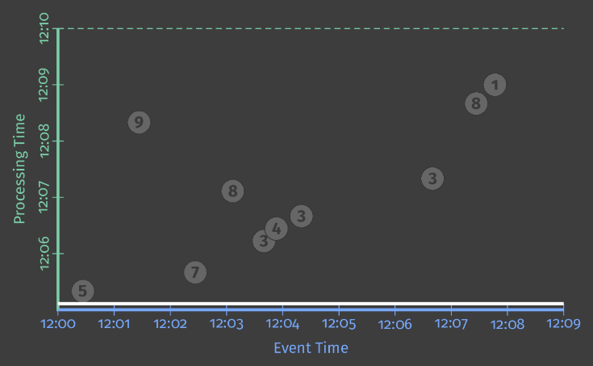
What Where When How
What: Computing Integer Sums
Notes:
This graph shows a sample data set of points scored for a specific team in our mobile gaming application. On the x-axis we’ve got event time, and the y access is processing time.
<animate> If everything was perfect, elements would arrive in our system immediately, and so we’d see things along this dashed line. But distributed systems often don’t cooperate.
<animate> Sometimes it’s not so bad. So here this event from just before 12:07 maybe just encountered a small network delay and arrives almost immediately after 12:07.
<animate> But this one over here was more like 7 minutes delayed. Perhaps our user was playing in an elevator or in a subway -- so the score is delayed by a temporary lack of network connectivity. And the margins of this graph can’t even contain what we’d see if our game supports an offline mode. If a user is playing on a transatlantic flight in airplane mode, it might be hours until that flight lands and we get those scores for processing.

Slide 34
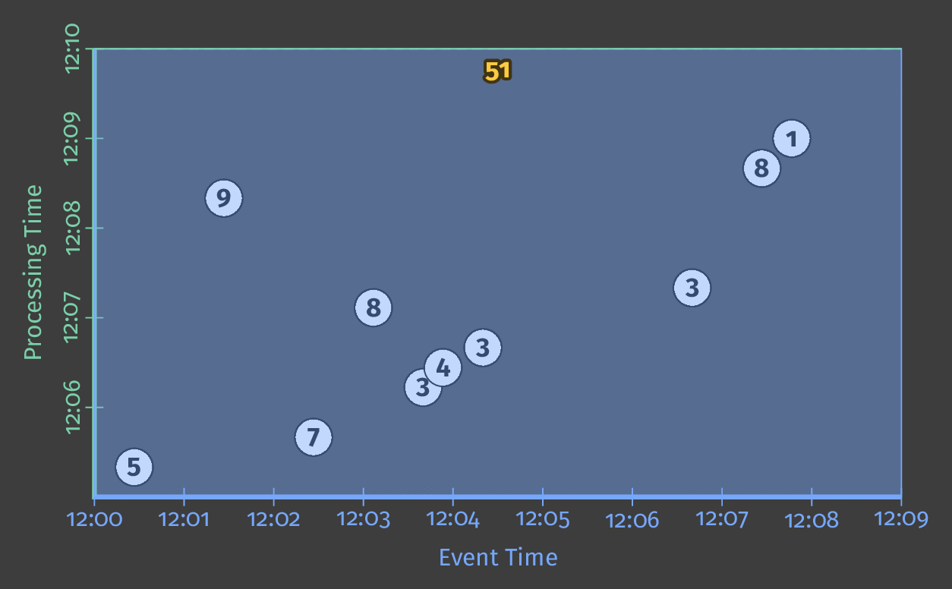
What Where When How
What: Computing Integer Sums
Notes:
In this animation, time is progressing top to bottom with the thick white line.
As the pipeline processes elements, they’re accumulated into the intermediate state, represented by that bold number at the top of white rectangle.
Once all of the input has been read, the pipeline produces output represented by the blue rectangle.
When we’re executing over a bounded PCollection, all the data is available when we start and can all be processed together, so the rectangle covers all events, no matter when in time they occurred.
But with unbounded PCollection, we can’t wait to have all the data or we’ll never make any progress. A common thing to do to ensure we can make progress when processing infinite data is to window the data...

Slide 35
What Where When How
Where in event time?
Windowing divides data into event-time-based finite chunks.
Often required when doing aggregations over unbounded data.
Fixed
Sliding
Sessions
1
2
3
4
1
2
3
1
3
4
Key 1
Key 2
Key 3
4
5
2
Time
Notes:
Windowing answers the second question by creating individual results for different slices of event time.
Windowing divides a PCollection up into finite chunks based on the event time of each element. It can be useful for computations over both bounded and unbounded PCollections, but it’s required when trying to aggregations on infinite data.
There many different way to window data, but some of the common ones include fixed time (like hourly, daily, monthly), overlapping sliding windows (like the last 24 hours worth of data, every hour), and session based windows that capture bursts of user activity.

Slide 36
What Where When How
Where: Fixed 2-minute Windows
PCollection<KV<String, Integer>> scores = input
.apply(Window
.into(FixedWindows.of(Duration.standardMinutes(2)))
.apply(Sum.integersPerKey());
Notes:
In our running example, we’ll use fixed windows that are 2 minutes long. Here I’ve highlighted the change to the code.
Let’s first see how this would behave in a batch execution mode.

Slide 37
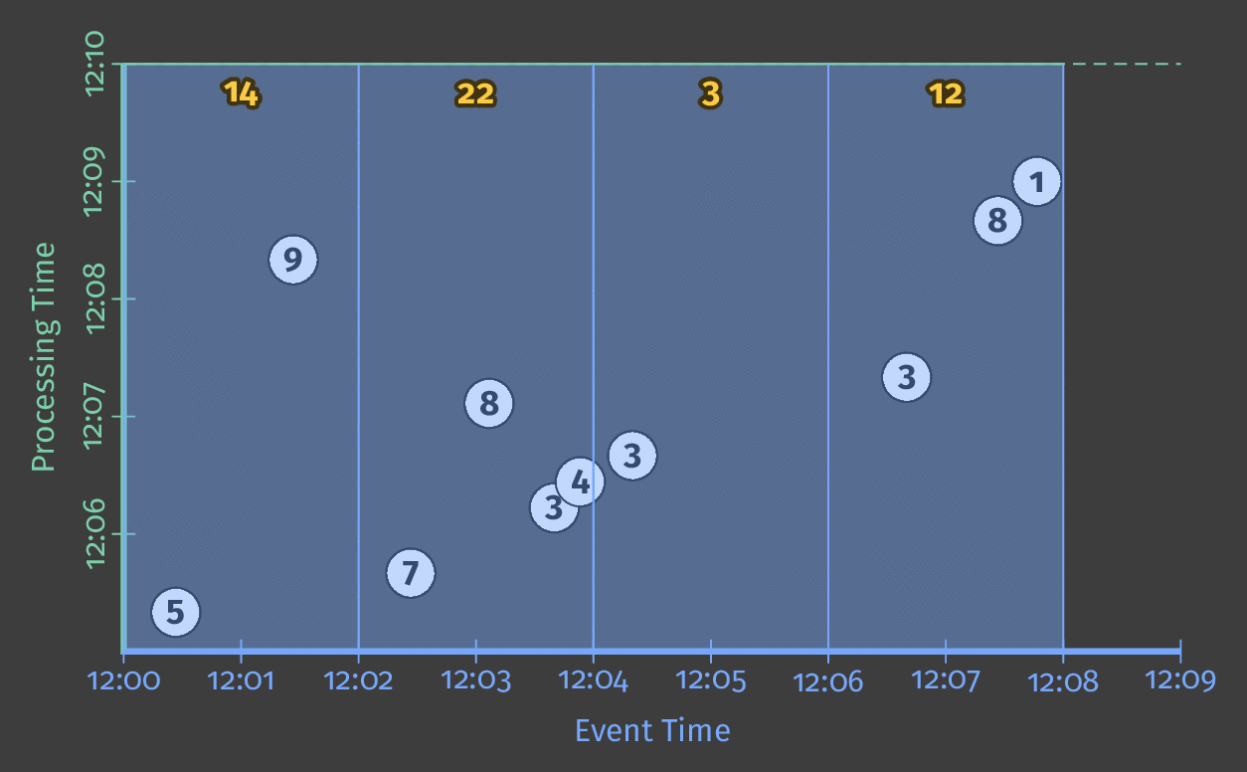
What Where When How
Where: Fixed 2-minute Windows
Notes:
Now if we look at how things execute, you can see that we are calculating a independent answer for every two minute period of event time.
But we’re still waiting until the entire computation completes to emit any results. That might work fine for bounded data sets, when we’ll eventually finish processing. But it’s not going to work if we’re trying to process an infinite amount of data!
If we want to start producing results as they are ready, we need a mechanism for controlling when each result is produced.

Slide 38
What Where When How
When in processing time?
Triggers control when results are emitted.
Triggers are often relative to the watermark.
Notes:
Triggers control when we should go ahead and emit a result for a window.
Triggers are often relative to the watermark, which is that heuristic about event time progress.

Slide 39
What Where When How
When: Triggering at the Watermark
PCollection<KV<String, Integer>> scores = input
.apply(Window
.into(FixedWindows.of(Duration.standardMinutes(2))
.triggering(AtWatermark()))
.apply(Sum.integersPerKey());
Notes:
So now, let’s request that results are emitted when we think we’ve roughly seen all the elements for a given window.
Triggering at the watermark actually the default -- I’ve just written it for clarity.
So now, let’s see what this trigger does when executing our pipeline….

Slide 40
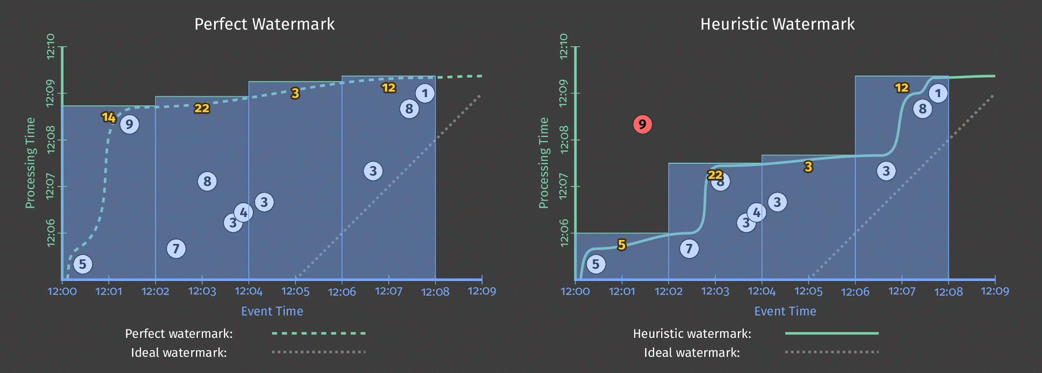
What Where When How
When: Triggering at the Watermark
Notes:
Again, we’ve got our 4 two minute windows here. However, we now emit the result from each window as soon as the watermark passes.
The graph of the left shows what would happen if we had a perfect watermark. But the graph on the right is what happens if we have to rely on a heuristic watermark. Element 9 was very late due to that lack of cell signal in the elevator, and was much more delayed than expected -- so in this case it came in late after the watermark and was never included in our results.
And even though we are getting results as soon as the watermark passes, it is often nice to get early, speculative results. For example, if we were windowing into daily window, we might still like to know how things are looking every couple hours.
We can work around this with a more advanced trigger.

Slide 41
What Where When How
When: Early and Late Firings
PCollection<KV<String, Integer>> scores = input
.apply(Window
.into(FixedWindows.of(Duration.standardMinutes(2))
.triggering(AtWatermark() .withEarlyFirings(AtPeriod(Duration.standardMinutes(1)))
.withLateFirings(AtCount(1))))
.apply(Sum.integersPerKey());
Notes:
Here we’ve changed the trigger so that instead of just emitting elements at the watermark, it also creates speculative results every minute, continues to fire as the watermark passes, and fires again when late data comes in.
Back to our animation...

Slide 42
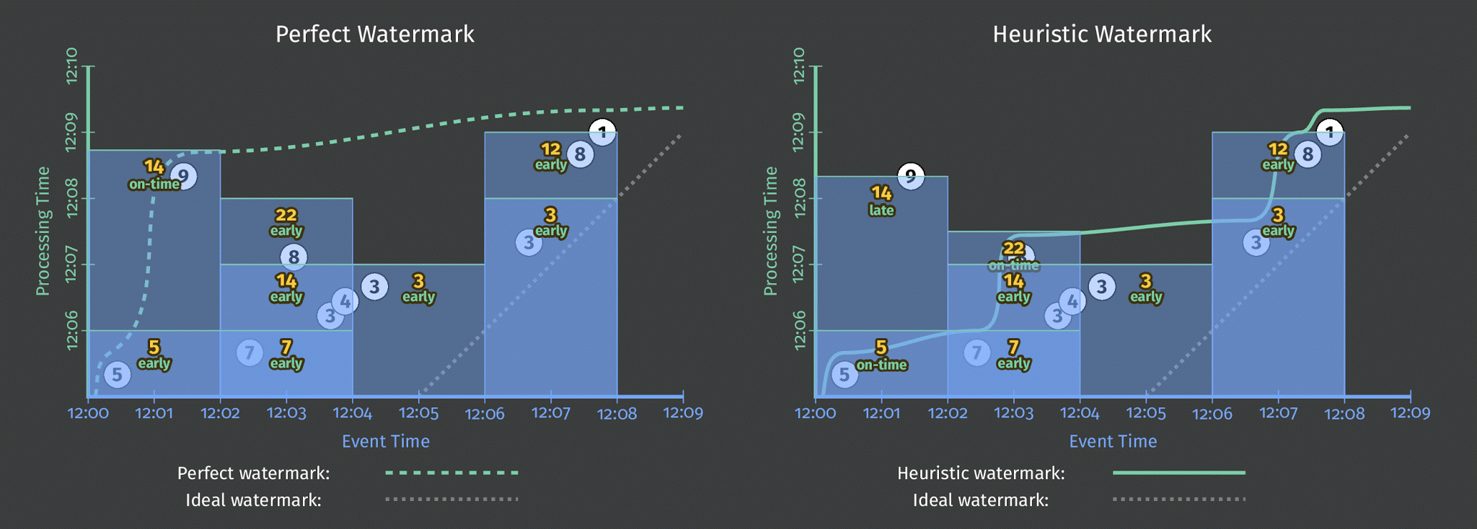
What Where When How
When: Early and Late Firings
Notes:
Now our first window produces its result at the watermark, but also gives an updated result when late value 9 comes in.
And that second window has two speculative results, with values 7 and 14, before we finally output the final result of 22.
There’s one final things we’d like to be able to tune...

Slide 43
What Where When How
How do refinements relate?
How should multiple outputs per window accumulate?
Appropriate choice depends on consumer.
Firing | Elements
Speculative | 3
Watermark | 5, 1
Late | 2
Total Observ | 11
Discarding
3
6
2
11
Accumulating
3
9
11
23
Acc. & Retracting*
3
9, -3
11, -9
11
*Accumulating & Retracting not yet implemented in Apache Beam.
Notes:
And that is what happens when we start emitting multiple results per window.
Let’s say we fire three times for a window -- a speculative firing that contains the value 3, then firing write at the watermark where we have two more values 5 and 1, and finally a late value 2.
One option is just to emit new elements that have come in since the last result. If we’ve got consumer that can handle doing that final sum like sql database, this works great. However, if we’re just writing the results out to a log file, then we’d have no log entry that represent our complete sum.
We could produce the running sum every time. Here the last result is the complete sum, but a consumer who is unaware of how these partial values relate ends up counting too high.
So the final option is to produce both the new running sum and retract the old one.

Slide 44
What Where When How
How: Add Newest, Remove Previous
PCollection<KV<String, Integer>> scores = input
.apply(Window
.into(Sessions.withGapDuration(Duration.standardMinutes(1)))
.triggering(AtWatermark() .withEarlyFirings(AtPeriod(Duration.standardMinutes(1)))
.withLateFirings(AtCount(1)))
.accumulatingAndRetractingFiredPanes())
.apply(Sum.integersPerKey());
Notes:
So I’m going to go for broke here and swap this example to use Session windowing as well.
This shows how easy it is mix and match different windowing strategies. Now instead of fixed 2 minute windows, we’re identifying periods of user interaction separated by gaps of at least a minute.
We’ve also changed things to report both accumulating results and retract old results.
Now, we’re both accumulating and retracting. This means, any time we output a refined value, we also issue a retraction for the previous value or values.

Slide 45
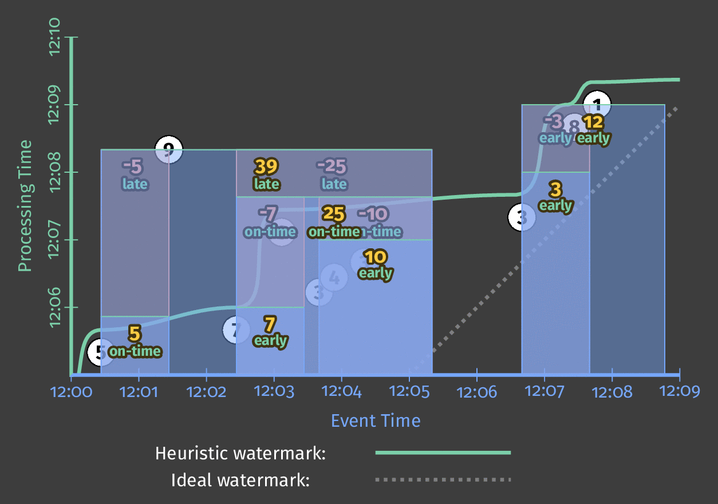
What Where When How
How: Add Newest, Remove Previous
Notes:
Now we’ve got speculative results, on time results, and retractions. Since we’re doing sessions, the window sizes adjust as we identify what elements constitute the same period of user interaction.
So that gets pretty crazy, but...

Slide 46
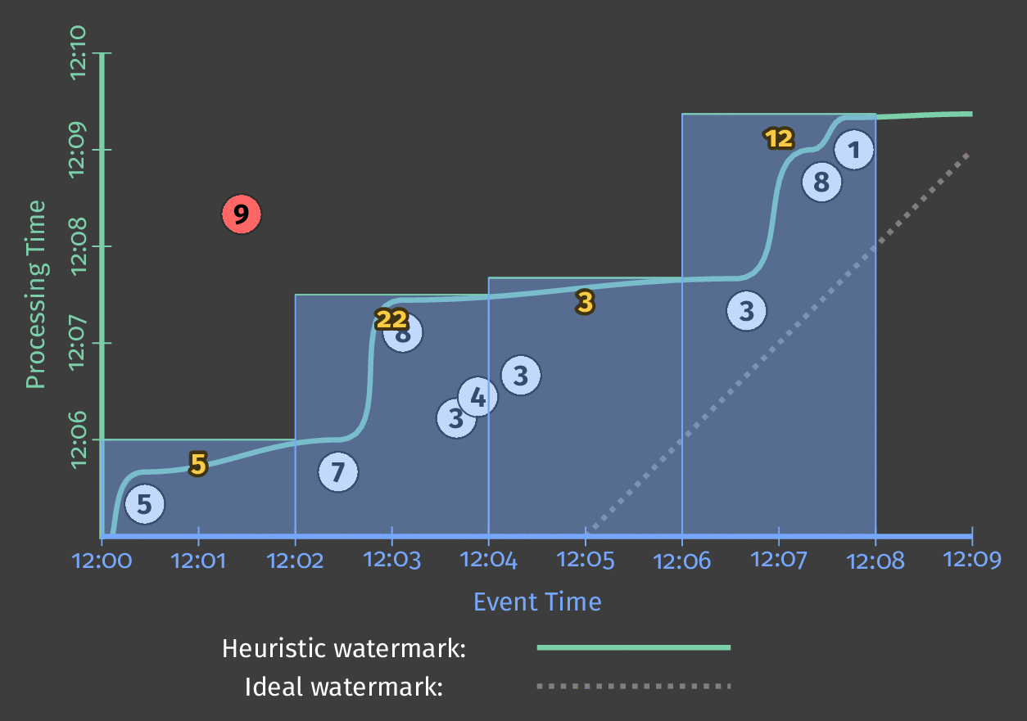
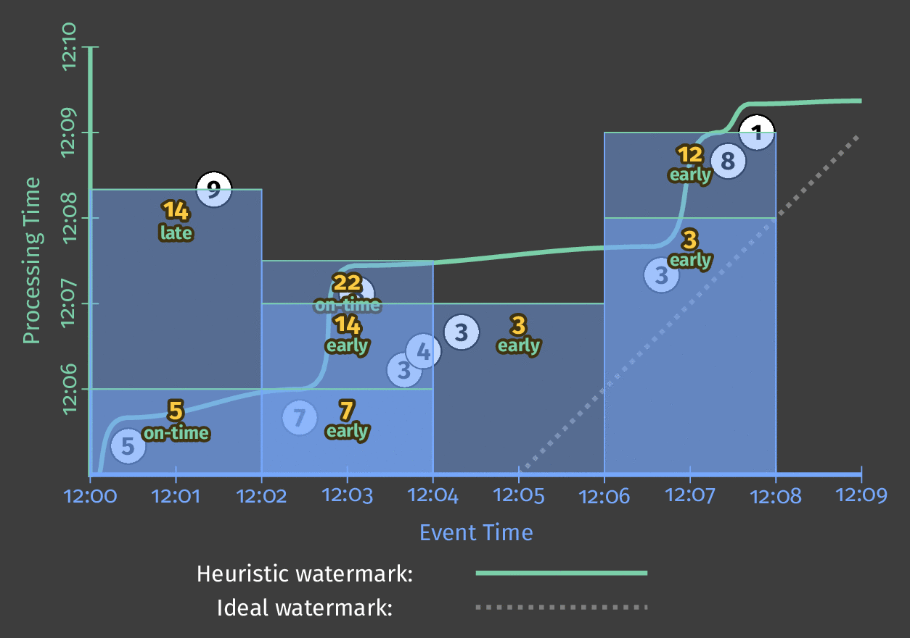
What Where When How
Customizing What When Where How
1.Classic Batch
2. Batch with Fixed Windows
3. Streaming
4. Streaming with Speculative + Late Data
5. Streaming With Retractions
Notes:
By tuning our what/where/when/how knobs, we’ve covered a wide spectrum of use cases:
We started with classic batch
Then we divided that up into event-time based windows
We started emitting those windows in a streaming fashion by triggering at the water mark.
We added in speculative and late data with a more advanced trigger
And finally, we went totally bonkers with sessions and retractions
And all throughout this -- we didn’t change our core algorithm at all.

Slide 47
Apache Beam
4

Slide 48

The Dataflow Model & Cloud Dataflow
Dataflow Model & SDKs
Google Cloud Dataflow
a unified model for batch and stream processing
no-ops, fully managed service
Notes:
Google took this new model for writing programs and create Google Cloud Dataflow, which included a fully managed Cloud service for executing these pipelines within Google Cloud Platform.
However, pretty quickly (in late January 2016) Google, along with some partners, ...

Slide 49
Beam
The Dataflow Model & Cloud Dataflow
Apache Beam
Google Cloud Dataflow
a unified model for batch and stream processing supporting multiple runtimes
a great place to run Beam
Notes:
… donated the programming model to the Apache Software Foundation, as the incubating project Apache Beam. In December 2016, Apache Beam graduated as a top-level project at the Apache Software Foundation.

Slide 50
What is Part of Apache Beam?
The Beam Model: What / Where / When / How
SDKs for writing Beam pipelines -- starting with Java
Runners for Existing Distributed Processing Backends
Apache Apex
Apache Flink
Apache Spark
Google Cloud Dataflow
Local (in-process) runner for testing
Notes:
Today, Apache Beam includes
the core unified programming model revolving around the what/where/when/how questions
the initial Java SDK that we developed as part of Cloud Dataflow, with others, including Python, to follow
and, most important for portability, multiple runners that can execute Beam pipelines on existing distributed process backends.

Slide 51
Apache Beam Technical Vision
End users: who want to write pipelines in a language that’s familiar.
SDK writers: who want to make Beam concepts available in new languages.
Runner writers: who have a distributed processing environment and want to support Beam pipelines
Beam Java
Other
Languages
Beam Python
Beam Model: Pipeline Construction
Runner A
Cloud Dataflow
Runner B
Beam Model: Fn Runners
Execution
Execution
Execution
Notes:
Our goal in Beam is to fully support three different categories of users
End users who are just interested in writing data processing pipelines. They want to use the language that they want to use and choose the runtime that works for them, whether it’s on premise, on a hand tuned cloud cluster, or on a fully managed service.
In addition, we want to develop stable APIs and documentation to allow others in the open source community to create Beam SDKs in other languages and to provide runners for alternate distributed processing environments.

Slide 52
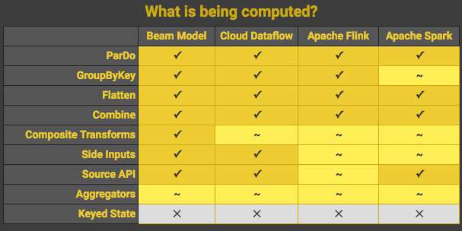
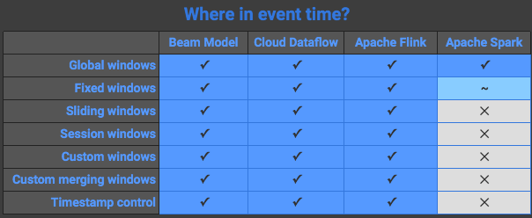
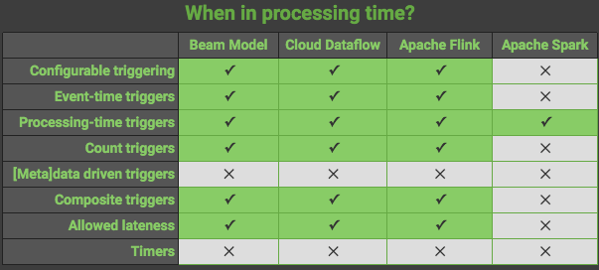
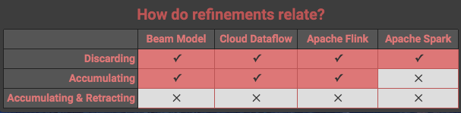
Categorizing Runner Capabilities
https://beam.apache.org/learn/runners/capability-matrix/
Notes:
While we’d love to have a world where all runners support the full suite of semantics included in the Beam Model, practically speaking, there will always be certain features that some runners can’t provide.
To help clarify things, we’ve been working on enumerating the key features of the Beam model in a capability matrix for all existing runners, categorized around the four key questions addressed by the model. This table will be maintained over time as the model evolves, our understanding grows, and runners are created or features added.

Slide 53
Growing the Beam Community
Collaborate - Beam is becoming a community-driven effort with participation from many organizations and contributors
Grow - We want to grow the Beam ecosystem and community with active, open involvement so Beam is a part of the larger OSS ecosystem
Notes:
We want to grow a larger Beam community - it will be a key to the project’s success.

Slide 54
Apache Beam Roadmap
02/25/2016
1st commit to ASF repository
Early 2016
Internal API redesign Slight Chaos
Late 2016
Multiple runners execute Beam pipelines
Mid 2016
API Stabilization
02/01/2016
Enter Apache Incubator
Notes:
Beam entered incubation in early February and quickly did the first few commits that did the code donations for the the Dataflow Java SDK, Flink Runner, and Spark Runner.
Our initial work is to focus on stabilizing internal APIs and integrating the additional runners. Expect some mild chaos and breaking changes.

Slide 55













The Evolution of Apache Beam
Colossus
BigTable
PubSub
Dremel
Google Cloud Dataflow
Spanner
Megastore
Millwheel
Flume
MapReduce
Apache Beam
Notes:
So to summarize this talk in a single slide --
Google published the original paper on MapReduce in 2004, which fundamentally change the way we do distributed processing.
<animate> Inside Google, engineers kept innovating and continued to publish papers about these new ideas -- include FlumeJava and Millwheel.
<animate> Externally the open source community created it’s own MapReduce implementation in Hadoop. An entire data processing ecosystem developed, and occasionally some of this was influenced by those Google papers.
<animate> In 2014, Google announced Google Cloud Dataflow, which was based on it’s internal technology. Google Cloud Dataflow included both a new programming model for writing both batch and streaming data processing pipelines, as well as a fully managed service for executing them.
<animate> In January 2016, Google, along with a handful of partners donated this programming model to the Apache Software Foundation, as the incubating project Apache Beam. Beam is designed for portability and integration with existing tools in the OSS ecosystem. In December 2016, Beam graduated as a top-level project at the Apache Software Foundation.

Slide 56
Learn More!
Apache Beam https://beam.apache.org
The World Beyond Batch 101 & 102 https://www.oreilly.com/ideas/the-world-beyond-batch-streaming-101 https://www.oreilly.com/ideas/the-world-beyond-batch-streaming-102
Join the Beam mailing lists! user-subscribe@beam.apache.org dev-subscribe@beam.apache.org
Follow @ApacheBeam on Twitter

Slide 57
Thank you!
Notes:
[Thank you for using this slide deck and sharing your enthusiasm about Beam! If you receive any interesting questions, please consider adding the to the community driven Talk FAQ. And feel free to add comments to the deck or contact the authors directly.]

